Slide 1
Week 2: Inferential Statistics 1 (ANOVA)
A.Kor@leedsbeckett.ac.uk

Slide 2
One-way ANOVA
ANOVA is to compare means
Compare the effectiveness of one treatment factor with two or more treatment factors
Step by Step Calculation (document)
http://oak.ucc.nau.edu/rh232/courses/EPS625/Handouts/One-Way%20ANOVA/Hand%20Calculation%20of%20ANOVA.pdf
http://www.mathandstatistics.com/learn-stats/hypothesis-testing/one-way-anova-by-hand
Step by Step Calculation (youtube)
https://www.youtube.com/watch?v=WUjsSB7E-ko

Slide 3
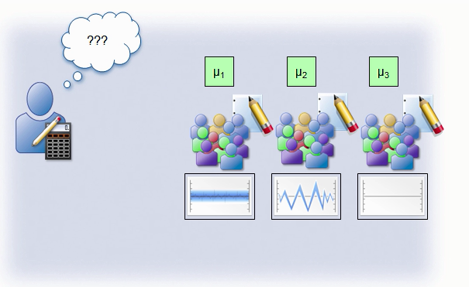
One-Way Anova
ANOVA
Test the means of more than 2 groups
Example (impact of noise on performance of groups 1, 2, 3 where means μ1, μ2, and μ3)

Slide 4
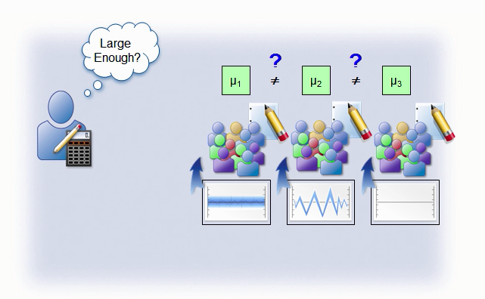
Are the performance means of the three samples equal or not equal?

Slide 5
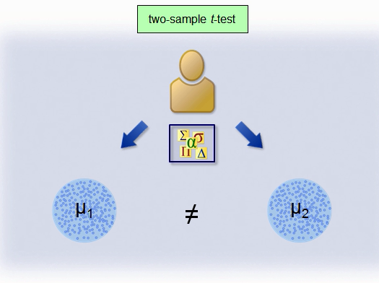
If it is a two sample t-test then the question is are the means of the two samples equal or not equal?

Slide 6
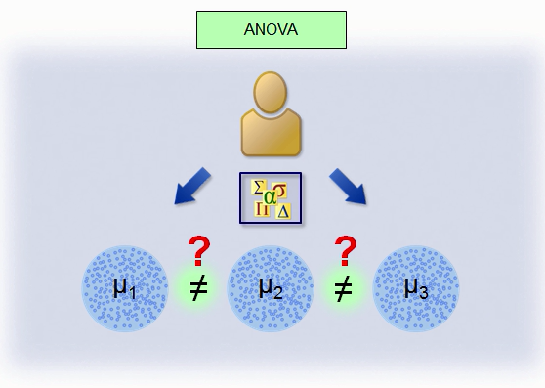
For ANOVA, the question is: Are the performance means of the three samples equal or not equal?

Slide 7
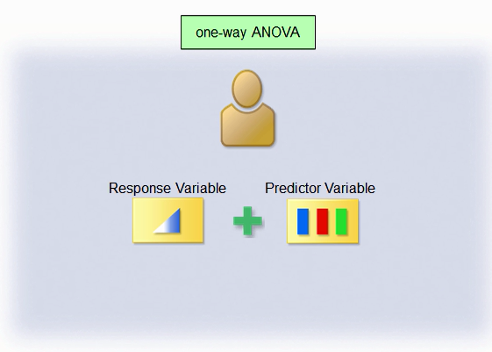
Dependent (response) variable – is a continuous variable; independent (factor or predictor) variable – is a categorical variable. One-way ANOVA – only 1 independent variable

Slide 8
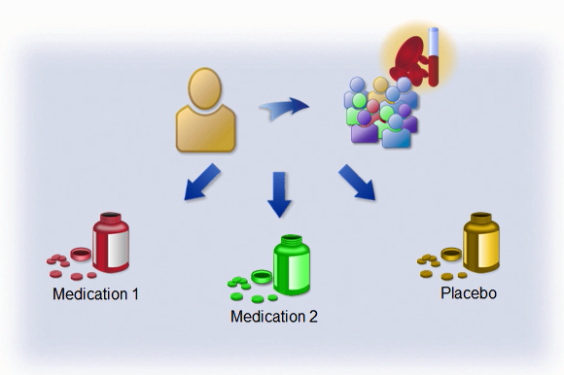
Blood Count (Response variable); Type of Medication (Predictor Variable – 3 levels) The question is: Is the means blood count for Medication 1, Medication 2, and Placebo significantly different?

Slide 9
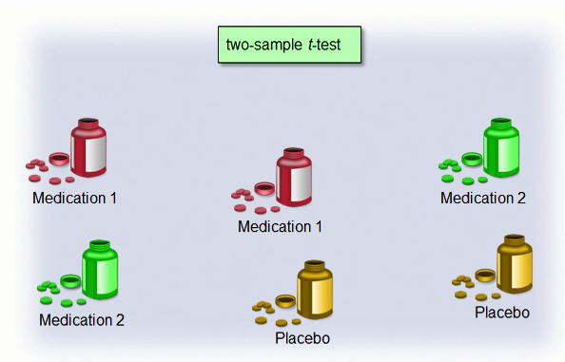
T-test – if we conduct 2-sample t-tests then we shall have 3 pairs of t-tests as shown below

Slide 10
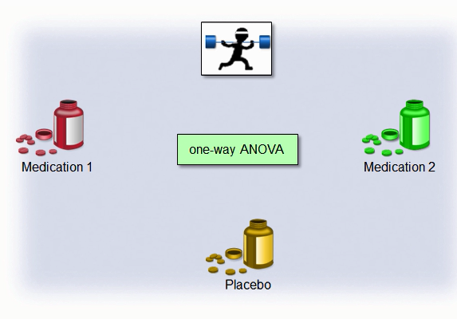
ANOVA Overview – the three pairs of t-tests could be replaced with a single One-Way ANOVA test

Slide 11
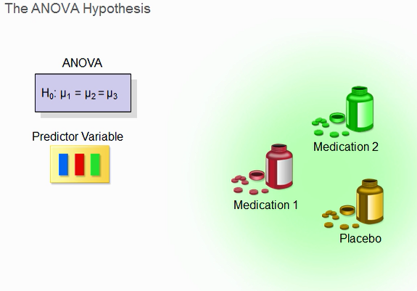
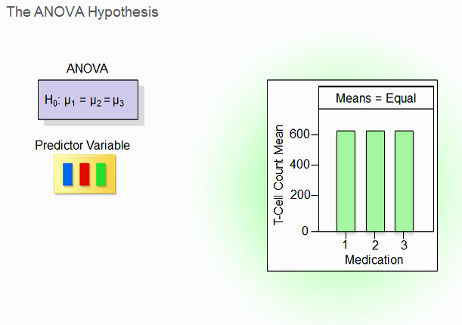
This is the null hypothesis

Slide 12
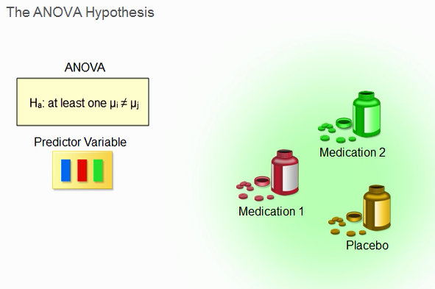
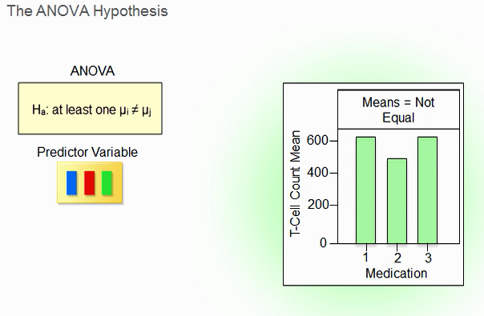
This is the alternative hypothesis

Slide 13
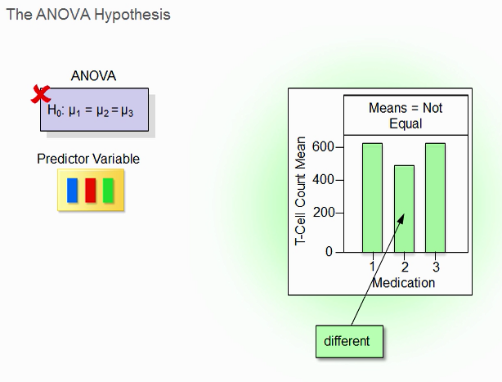
If one of the means is not equal -> reject null hypothesis

Slide 14
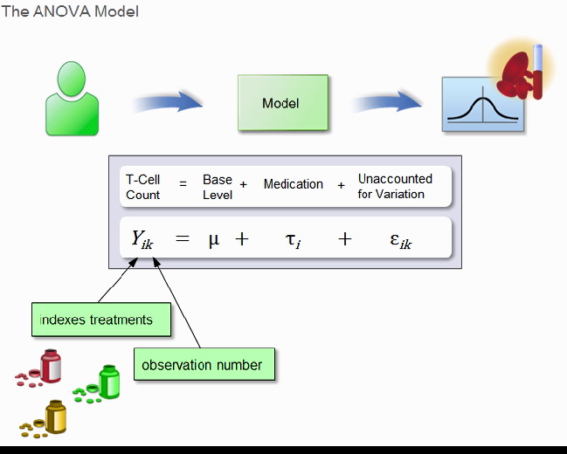
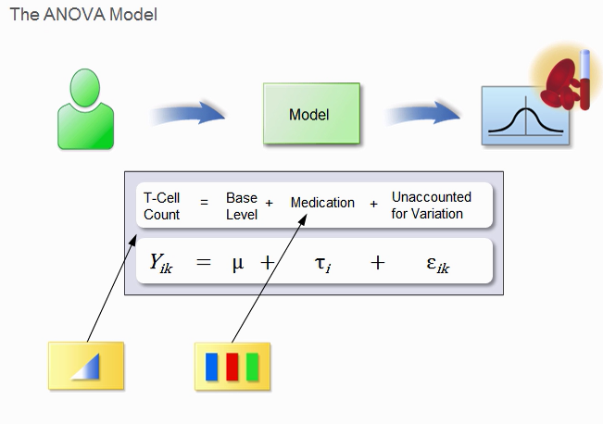
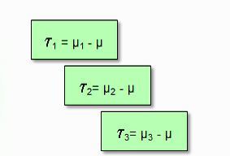
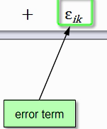
This is the model: i – indexes treatment, k = observation number, µ = overall population mean, τi = effect of medication (i = 1,2,3 for 3 types of medicine),

Slide 15
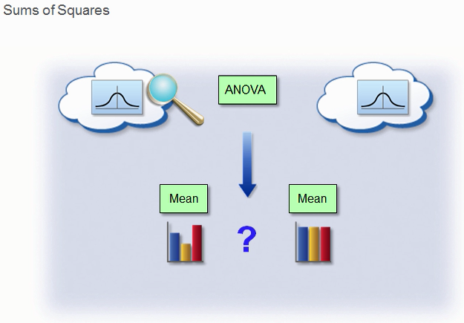
ANOVA – Analyses the variances of the groups to check whether there is any significant differences in the means

Slide 16
Underlying Concepts
Very good resource
http://statisticslectures.com/topics/onewayanova/
The step by step procedure for one way ANOVA is found in Excel sheet ANOVA_medication.xlsx
Note, I shall provide a recording for the explanation by this Wednesday

Slide 17
Excellent Resource
https://www.spss-tutorials.com/anova-what-is-it/
Look at the excel sheet (spss.xlsx)

Slide 18
Note:
A separate recorded explanation will be given for slides 18 to 31 and ANOVA_medication.xlsx by this Wednesday

Slide 19
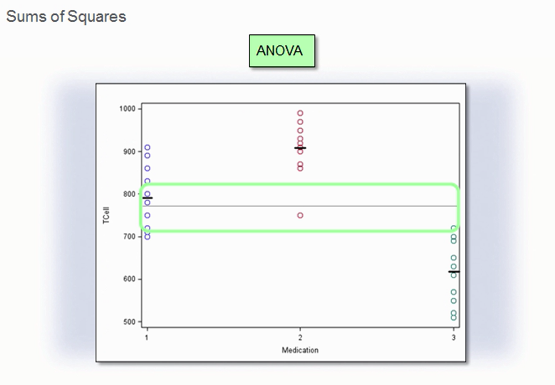
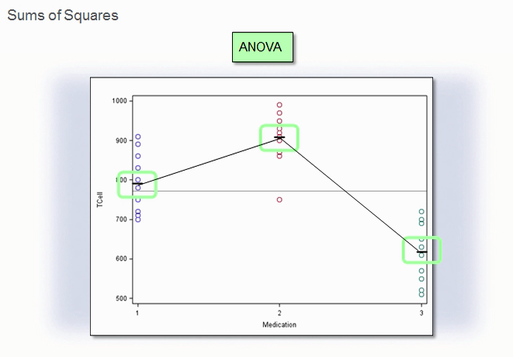
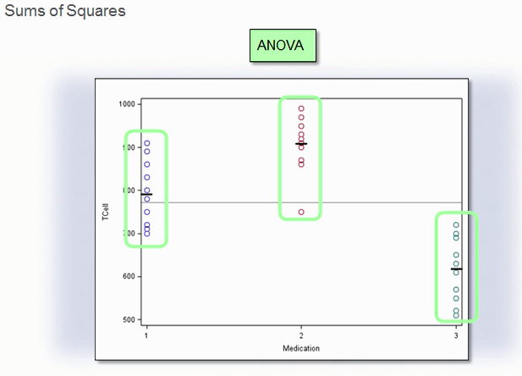
Variation of means between groups – calculate the variability of the 3 means
Mean of each group
________ Mean of all
the groups (grand mean)
Variation of observations within each group – calculate the variability of the observations within each group

Slide 20
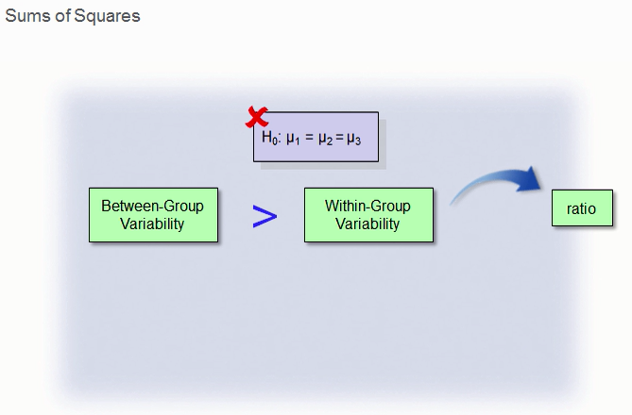
Calculate the ratio – reject null hypothesis
F = between groups/Within Groups
The larger the ratio, the more likely the groups have different means (thus, reject null hypothesis)

Slide 21
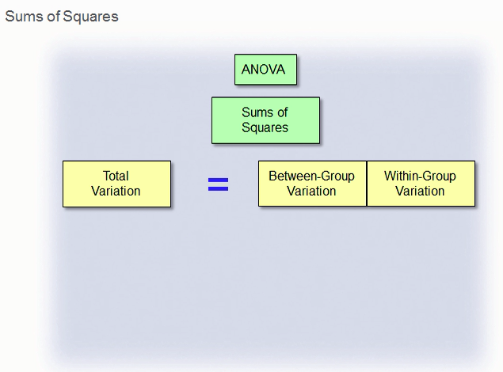
Calculate three types of sums of squares
http://support.minitab.com/en-us/minitab/17/topic-library/modeling-statistics/anova/anova-statistics/understanding-sums-of-squares/

Slide 22
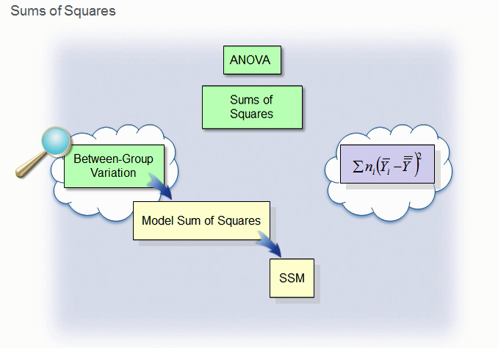
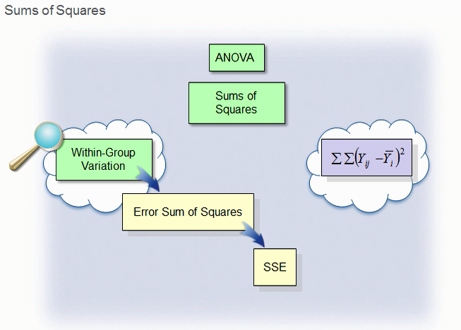
Mean of a group; Mean of all the groups; ni – number of observations for the group (do separately for groups 1, 2 and then 3) then total up the squares
Do individually for each observation within a group (i.e. square (observed value – mean of a group) followed by summing up for all the observed values within a group. Repeat for groups 2 and 3. Total for all the three groups.
Variation in the mean of each group from the grand mean (SSbetween)
Variation of each score from its group mean (SSwithin)

Slide 23
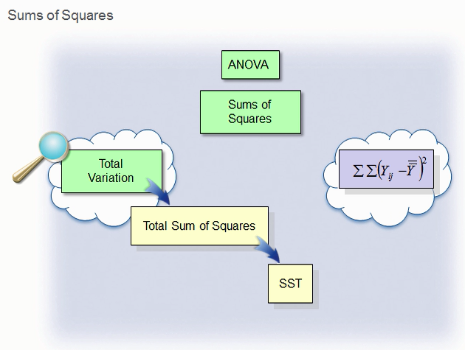
Total variation in the data from the grand mean
Start with group 1.
Find the difference of each observed value in group 1 from grand mean. Square the difference. Sum the squares for all the observed values in group 1.
Continue with groups 2 and 3.
Total variation = sum of squares for group 1 + sum of squares for group 2 + sum of squares for group 3.
SST – total sum of squares
Or SStotal = SSbetween + SSwithin

Slide 24
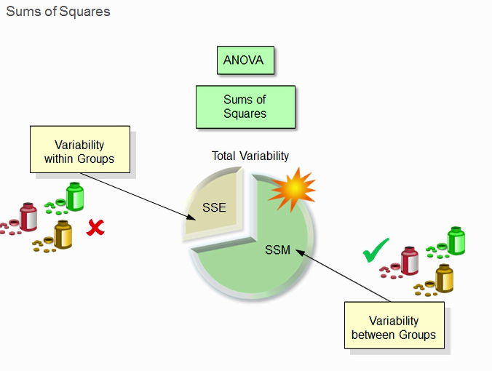
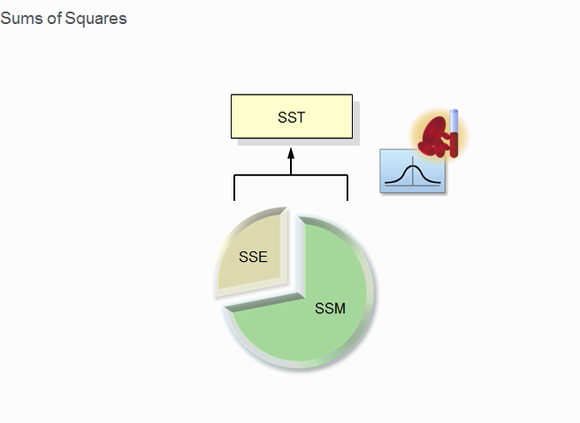
SST (SStotal) represents the overall variability of the T-cell count
SSE (SSwithin) – Error (or residual) sum of squares (variation within group); Total sum of squares within
SSM (SSbetween) – Model sum of squares (variation between groups); Total sum of squares between
SST = SSE + SSM
SStotal = SSwithin + SSbetween

Slide 25
F-Test
The (F) test compares the variation between the groups to the inherent variation within the groups.
http://www.stat.yale.edu/Courses/1997-98/101/anovareg.htm
Example, results of ANOVA, F(2,12) = 3.26, p = 0.02
F(a,b) – a is the degree of freedom between groups number of groups -1)
b is the degree of freedom for variance with the groups (total number of observations of all the groups – number of groups)

Slide 26
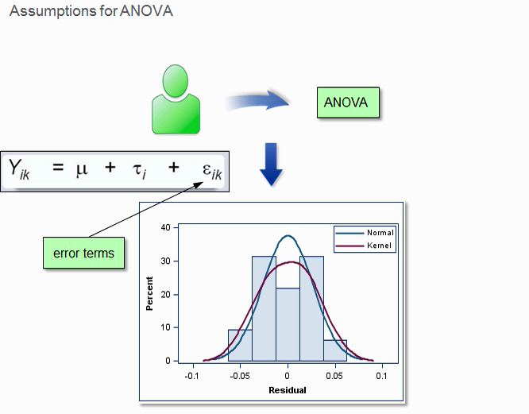
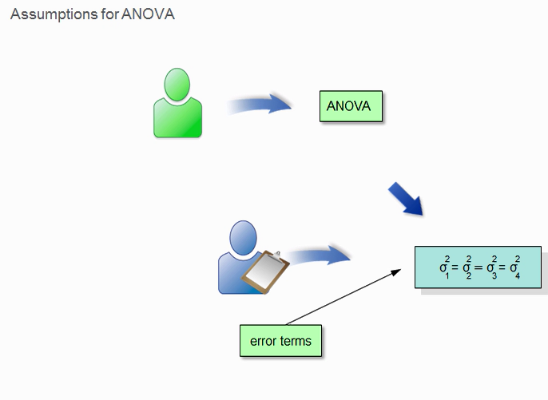
Assumptions for ANOVA
A good random representative sample?
Normal distribution of the error terms (diagnostic plots of the residuals)
Error terms have equal variances (plot residual versus predicted value to verify this)

Slide 27
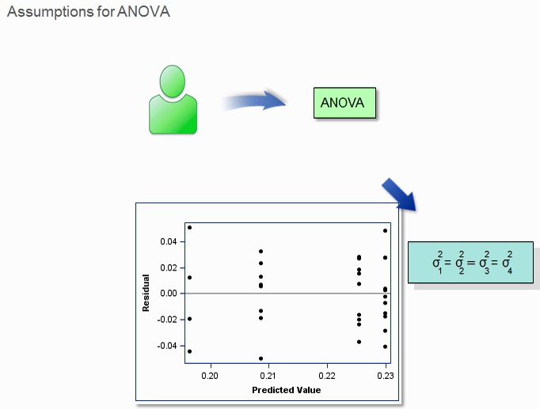

Slide 28
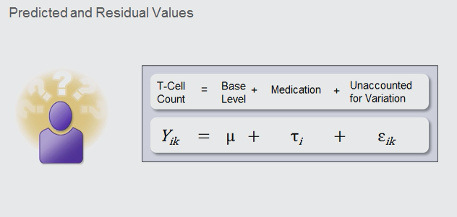
Predicted (Group Mean) and Residual (estimates of error term in model)Values

Slide 29
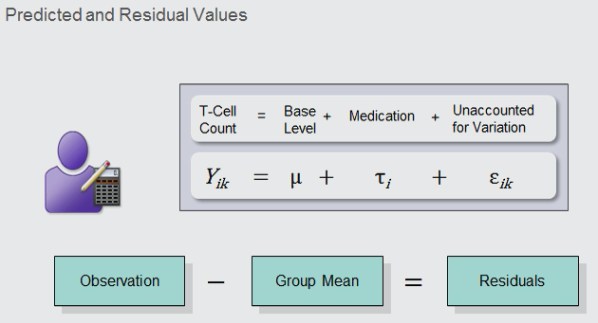

Slide 30
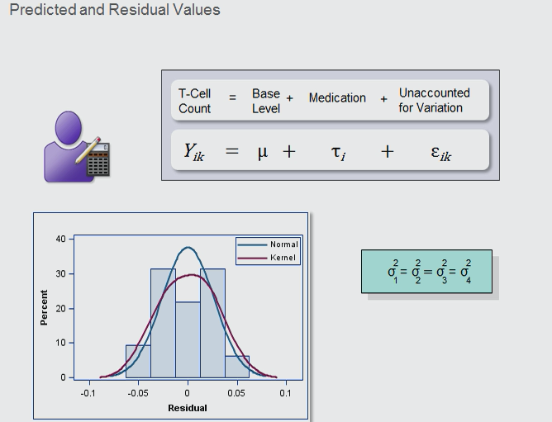
Verify Normality and Equal Variances

Slide 31
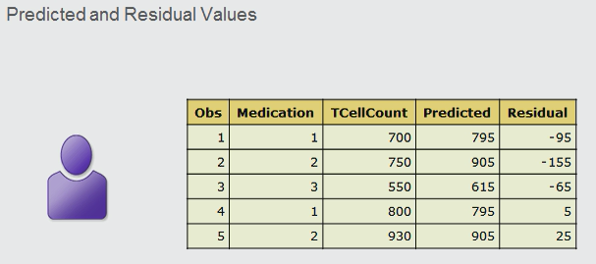

Slide 32
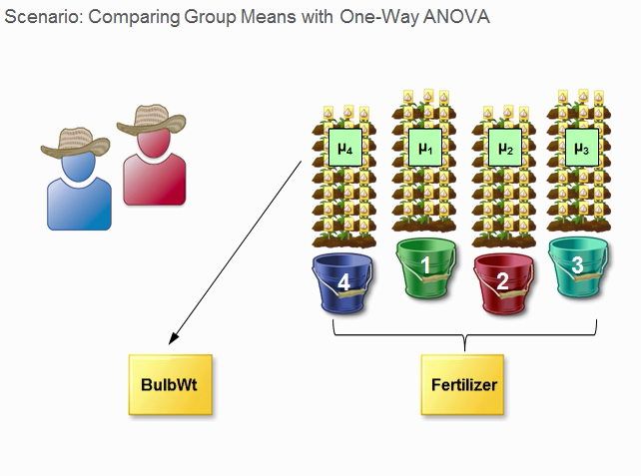
Example: Compare Group Means with One-Way ANOVA
32 bulbs in each plot with 3 types of fertilisers and 1 control (1-4)
Response variable (bulb weight); predicted variable fertiliser

Slide 33
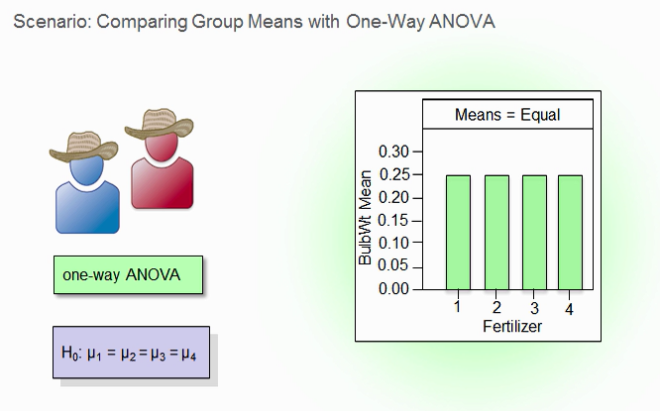
Null Hypothesis

Slide 34
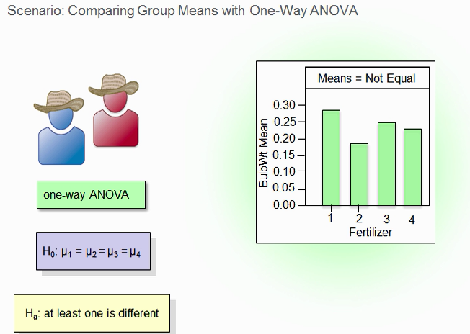
Alternative Hypothesis

Slide 35
One-Way ANOVA
Types I, II, III Sum of Squares (Type II is the default)
https://www.ibm.com/support/knowledgecenter/en/SSLVMB_23.0.0/spss/common/glm_general_factorial_sum_of_squares.html
http://md.psych.bio.uni-goettingen.de/mv/unit/lm_cat/lm_cat_unbal_ss_explained.html

Slide 36
Type I, II, III sums of square
http://md.psych.bio.uni-goettingen.de/mv/unit/lm_cat/lm_cat_unbal_ss_explained.html
Type I error – reject Ho when it is true (false positive)
Type 2 error – accept Ho when it is false (false negative)
Type 3 error – reject Ho for the wrong reason
Type 4 error – reject Ho but wrongly interpret results (a specific Type 3 error)
https://www.statisticshowto.datasciencecentral.com/type-iii-error-in-statistical-tests/

Slide 37
Definition of terms and concepts
Means and Least square means - http://webpages.uidaho.edu/cals-statprog/sas/workshops/glm/lsmeans.htm
Type I, Type III, sum of squares http://goanna.cs.rmit.edu.au/~fscholer/anova.php
https://www.uvm.edu/~dhowell/StatPages/More_Stuff/Type1-3.pdf
p value < α (0.05) means that there is significant difference

Slide 38
Two-Way ANOVA
Two-way ANOVA
A two-way ANOVA tests the effects of 2 independent variables (e.g. A, and B) on a dependent variable (must be numeric).
The test could be:
Effect of only one independent variable A
Effect of only one independent variable B
Effect of the interaction of A and B (i.e. effect of A combined with effect B)
Look at Example 8.4, pages 14-15

Slide 39
Look at the excel sheet again (will revisit in recording)
Model – between
Error – within
Total - total

Slide 40
Resources
One-way ANOVA (Part 1), A Visual Guide https://www.youtube.com/watch?v=JgMFhKi6f6Y
https://www.youtube.com/watch?v=ITf4vHhyGpc
One-way ANOVA (Part 2) Understanding the calculation https://www.youtube.com/watch?v=UrRYITjDOww
Two-way ANOVA (Part 1), An Introduction https://www.youtube.com/watch?v=i4mamuL_CF8

Slide 41
End

